Slide 1

Deep Learning Crash Course
Hui Xue
Fall 2021
www.deeplearningcrashcourse.org

Slide 2
Outline
Generative and discriminative model
Generative model, introduction
Key ideas motivating Generative Adversarial Network (GAN)
G/D game
Optimal solution of G/D gaming
Conditional GAN and Cycle GAN
Further extension of GAN framework

Slide 3
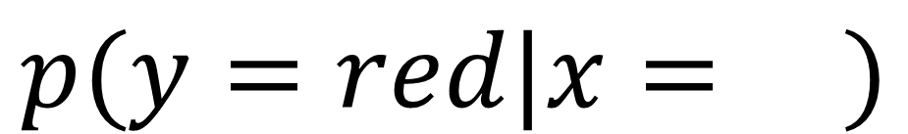
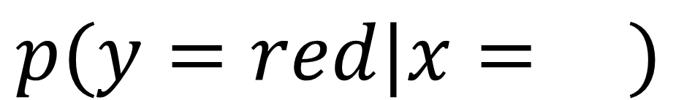
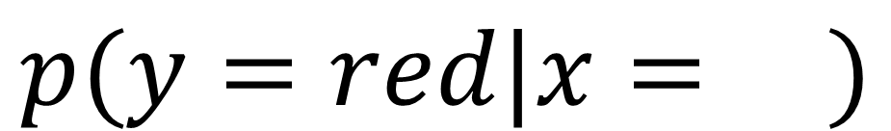
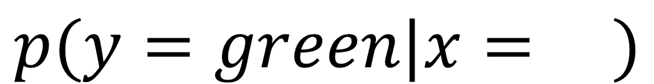
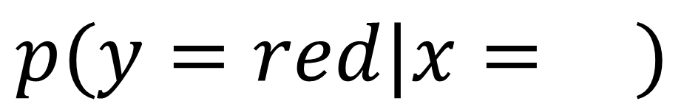
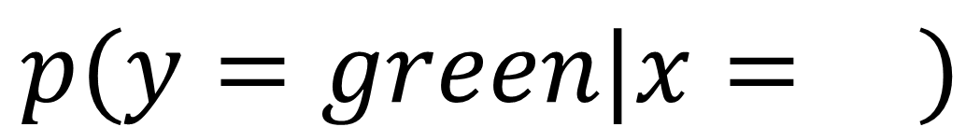
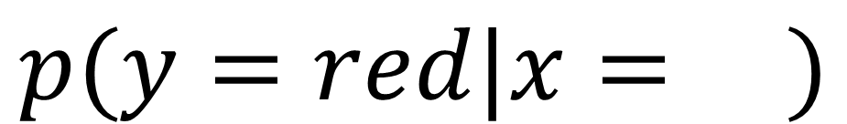
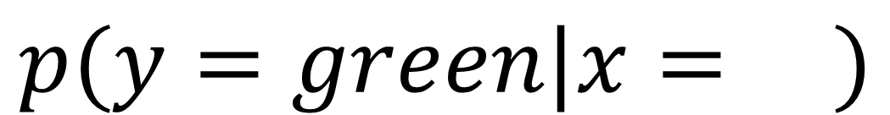
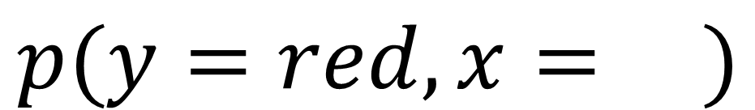
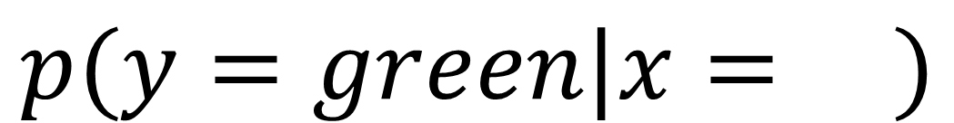
Generative and discriminative model
$$p(y=red|x= )$$
$$p(y=green|x= )$$
$$p(y=red|x= )$$
$$p(y=green|x= )$$
$$p(y=red|x= )$$
$$p(y=green|x= )$$
$$p(y=red|x= )$$
$$p(y=green|x= )$$
Discriminative: learn the decision boundary to make prediction, often with a functional form
Generative: learn the joint distribution between data and label to make prediction
$$p(y=red,x= )$$
$$p(y=red|x= )$$
Example: autoregression, GAN, variational autoencoder …
Example: logistic regression, CNN …

Slide 4
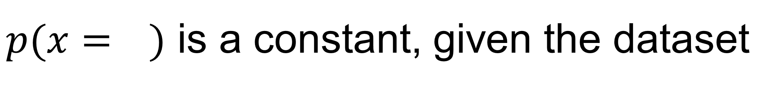
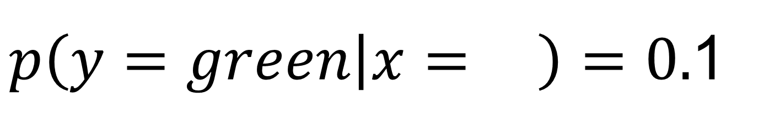
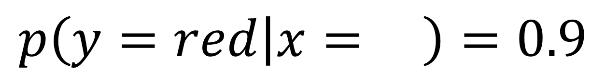
Linked by the Bayes Rule
$$p\left(y=red | x= \right)=\frac{p(y=red,x= )}{p(x= )}=\frac{p(x= |y=red)p(y=red)}{p(x= )}$$
$$p\left(y=red | x= \right)=0.9$$
$p(x= )$ is a constant, given the dataset
$p\left(y=green | x= \right)=0.$1
$$p(y=red,x= )>p(y=green,x= )$$
Discriminative model takes the short-cut.
Very suitable for supervised learning
This dot is red …
We can use joint probability to make prediction too

Slide 5
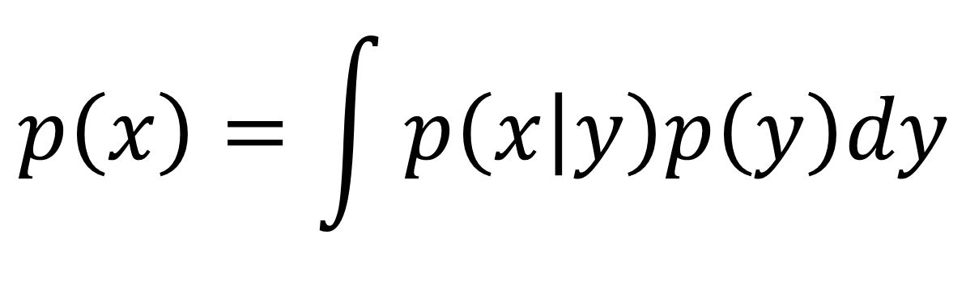
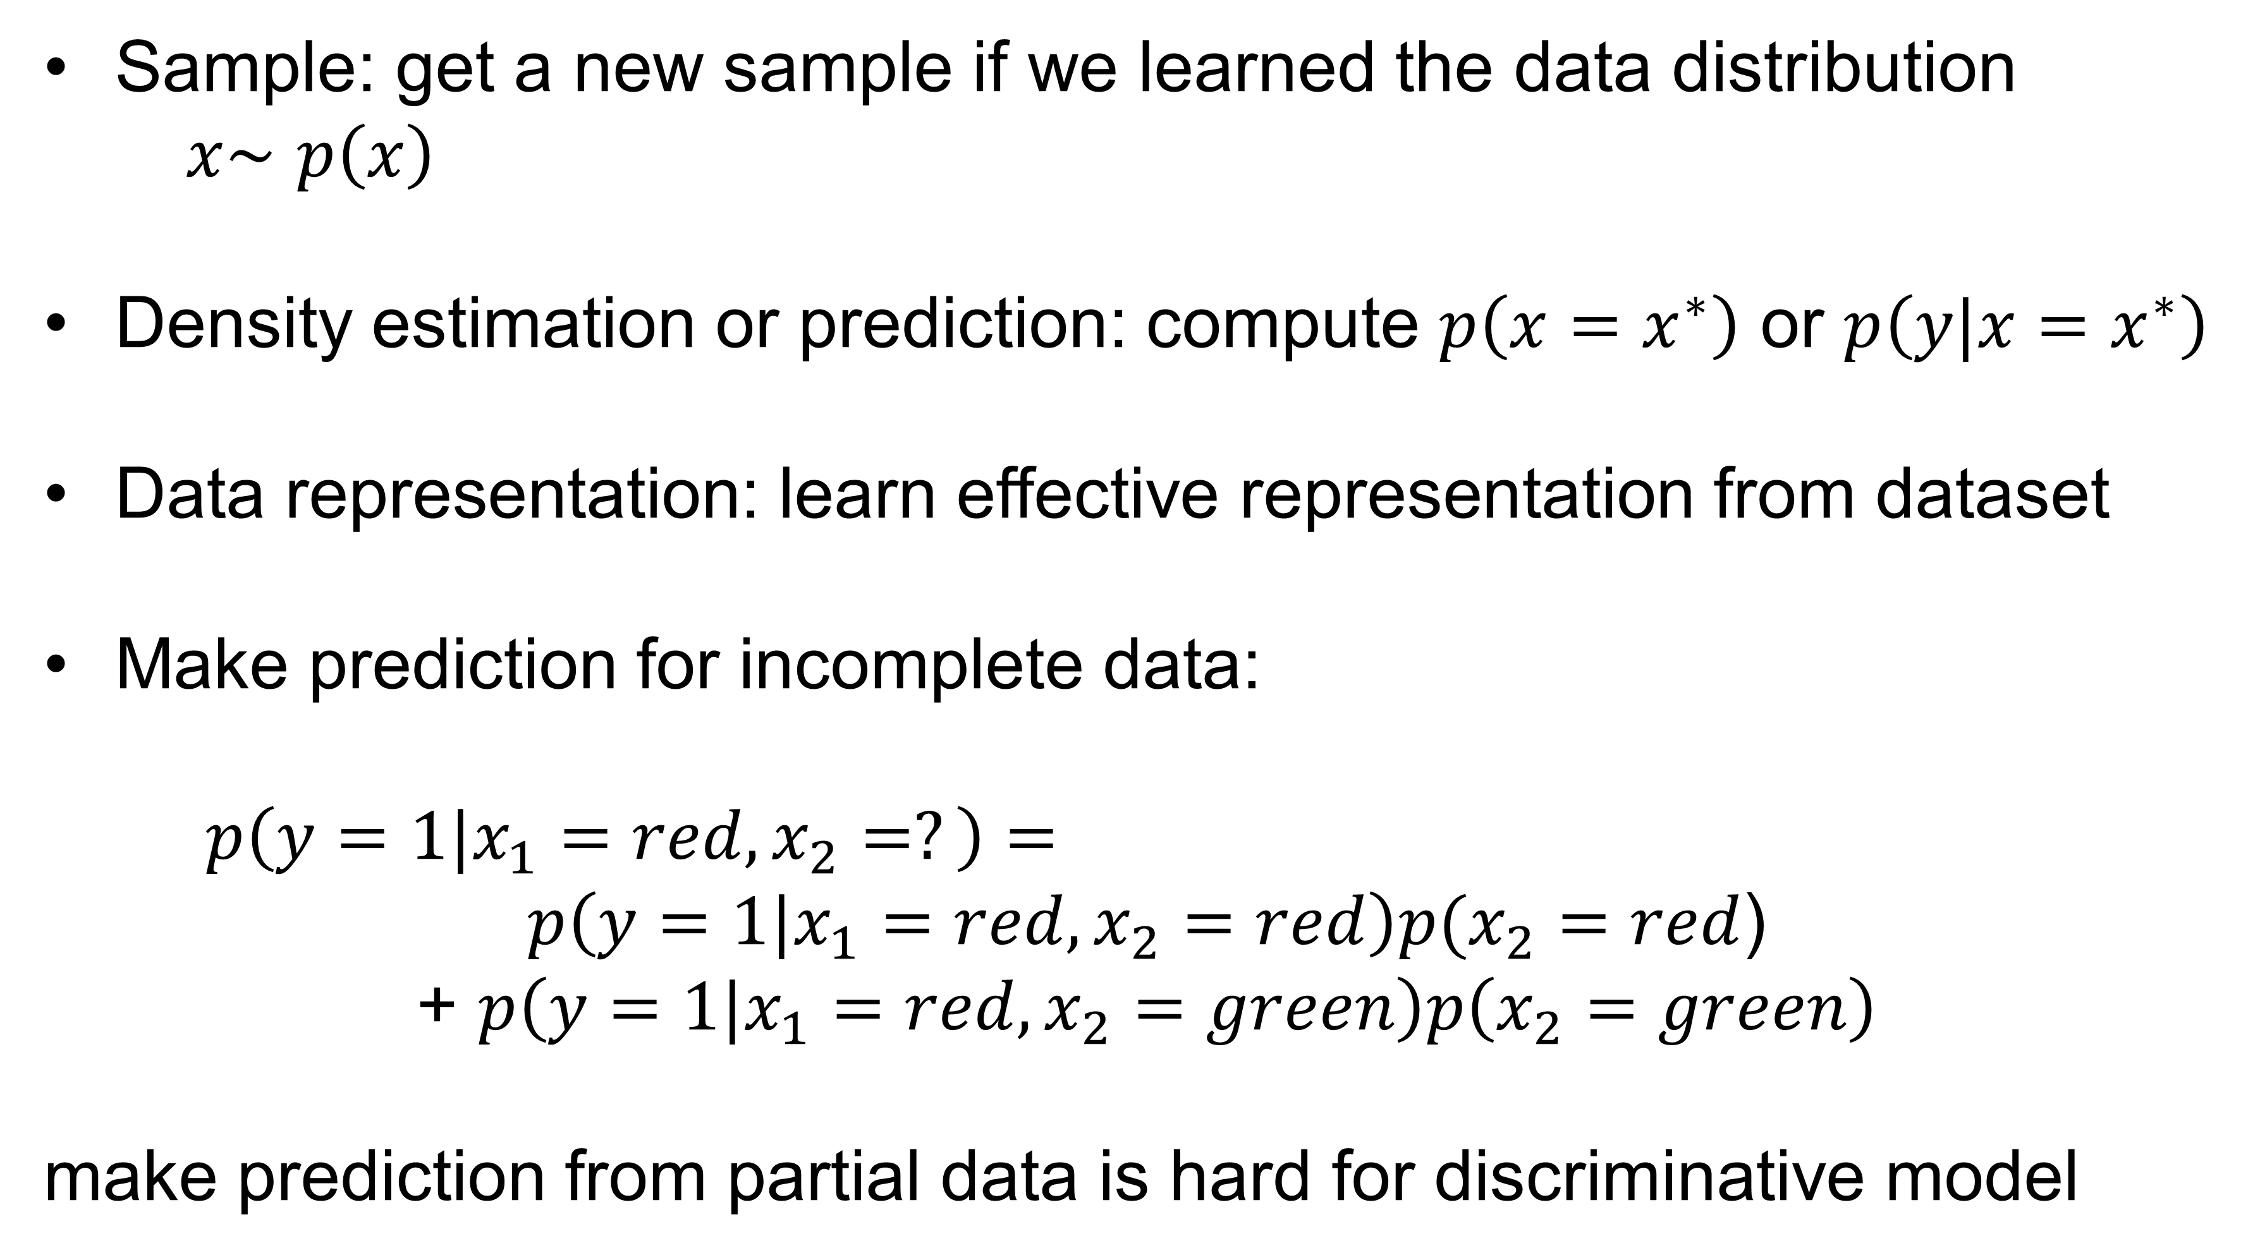
Generative model can do more
$$p\left(x\right)=\int{p\left(x | y\right)p\left(y\right)dy}$$
p(y) is the class prior, often can be estimated from counting class frequency
Sample: get a new sample if we learned the data distribution
$x\sim$ $p\left(x\right)$
Density estimation or prediction: compute $p\left(x=x^{∗}\right)$ or $p\left(y|x=x^{∗}\right)$
Data representation: learn effective representation from dataset
Make prediction for incomplete data:
$p\left(y=1|x_{1}=red,x_{2}=?\right)=$
$p\left(y=1|x_{1}=red,x_{2}=red\right)p(x_{2}=red$)
+ $p\left(y=1|x_{1}=red,x_{2}=green\right)p\left(x_{2}=green\right)$
make prediction from partial data is hard for discriminative model
Data distribution p(x)

Slide 6
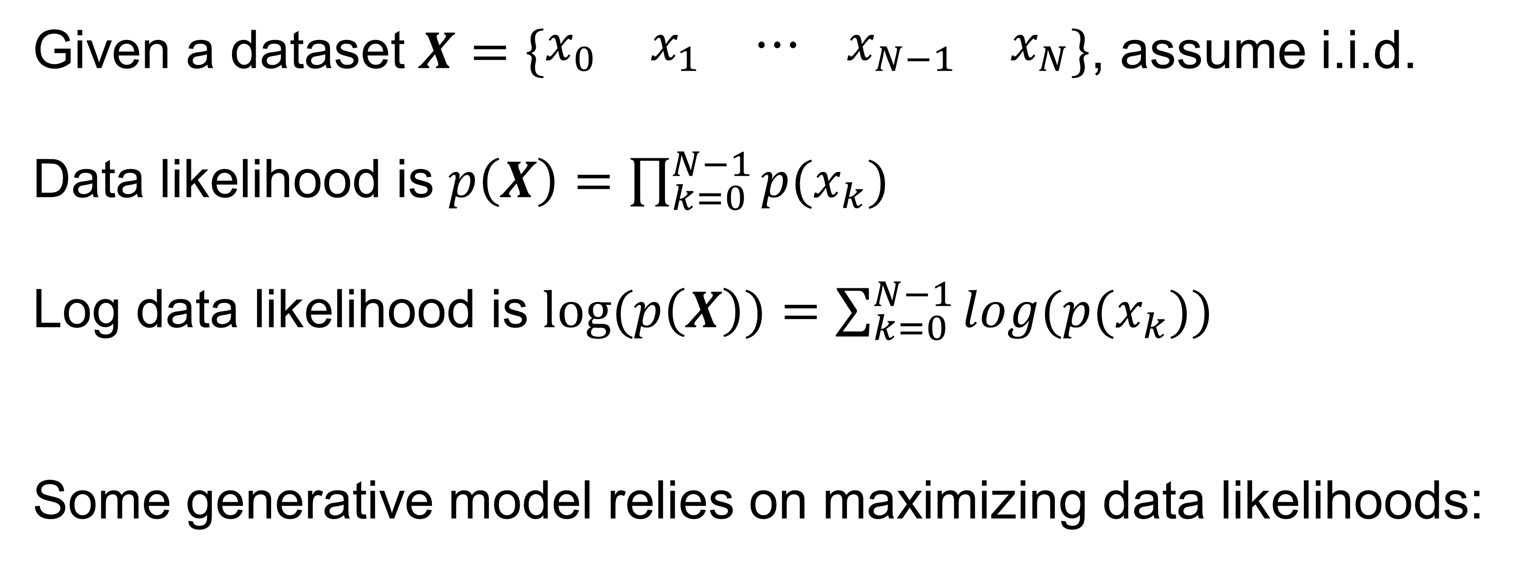
Generative model
Given a dataset $X=\left\{\begin{matrix}x_{0} & x_{1} & ⋯ \end{matrix}\begin{matrix}x_{N−1} & x_{N}\end{matrix}\right\}$, assume i.i.d.
Data likelihood is $p\left(X\right)=\prod_{k=0}^{N−1}{p(x_{k})}$
Log data likelihood is $log⁡(p\left(X\right))=\sum_{k=0}^{N−1}{log(p(x_{k}))}$
Some generative model relies on maximizing data likelihoods:
Autoregressive model : $p_{θ}\left(X\right)=\prod_{k=0}^{N−1}{p(x_{k}|x_{<k})}$, conditional dependence
Variational autoencoders : $p_{θ}\left(X\right)=\int{p\left(x | z\right)p\left(z\right)dz}$, latent variable
Flow model : $p_{θ}\left(X\right)=p(z=f_{θ}^{−1}(x))\left|det⁡(\frac{{∂f}_{θ}^{−1}(x)}{∂x})\right|$, functional transformation between latent and data variable
Differences are how to represent data likelihood and how to conduct learning

Slide 7
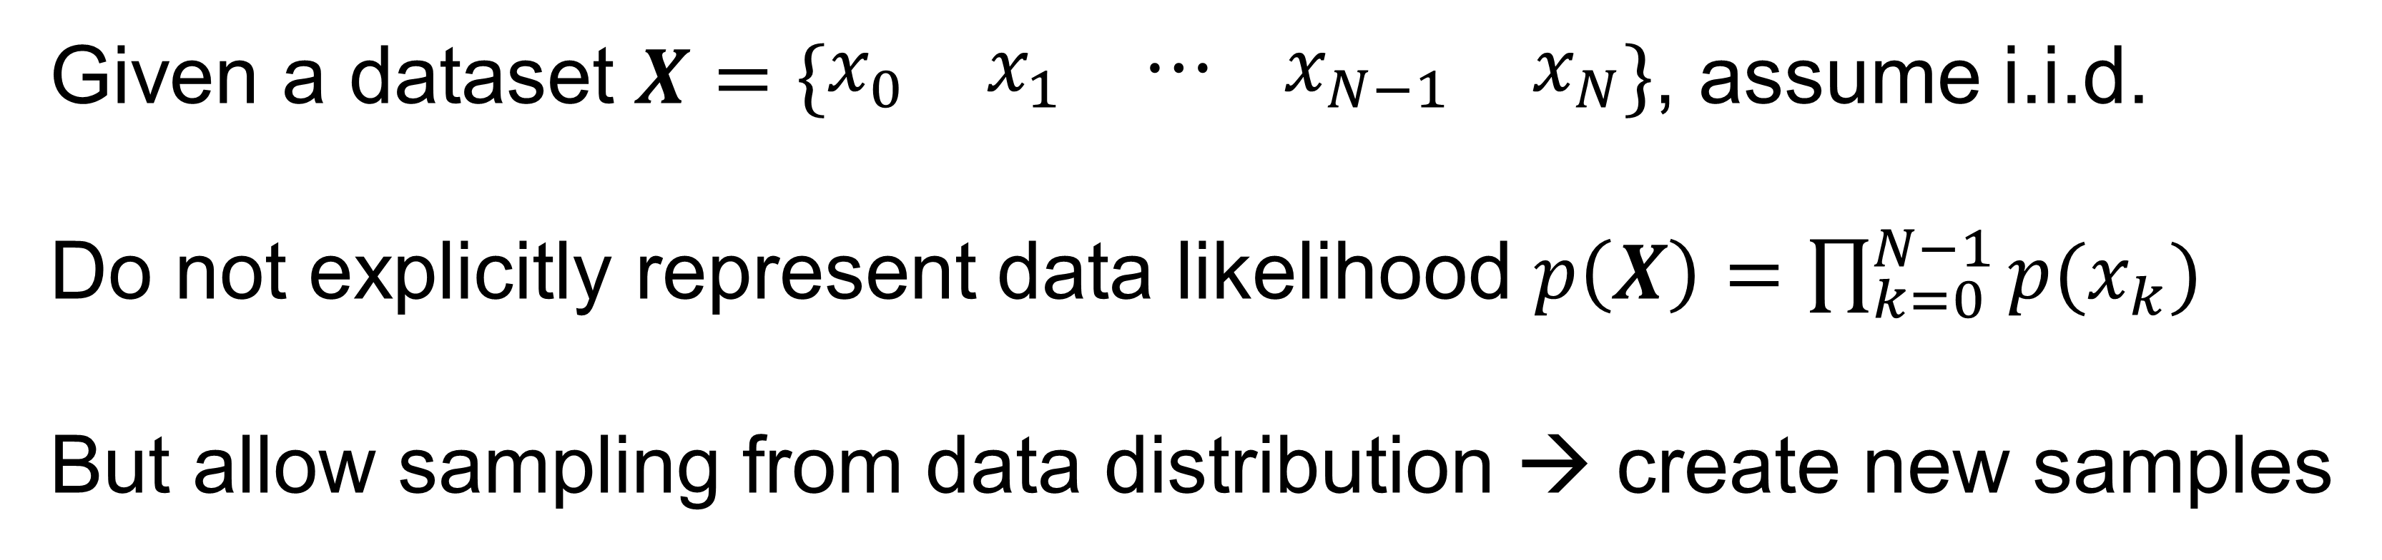
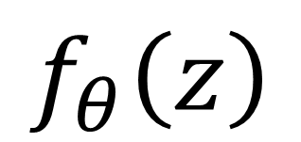
Implicit generative model
Given a dataset $X=\left\{\begin{matrix}x_{0} & x_{1} & ⋯ \end{matrix}\begin{matrix}x_{N−1} & x_{N}\end{matrix}\right\}$, assume i.i.d.
Do not explicitly represent data likelihood $p\left(X\right)=\prod_{k=0}^{N−1}{p(x_{k})}$
But allow sampling from data distribution → create new samples
$$f_{θ}\left(z\right)$$
Model can turn a latent vector to a data sample by learning the underneath data distribution
Do not allow density estimation
Can provide good data representation
Data distribution p(x)

Slide 8
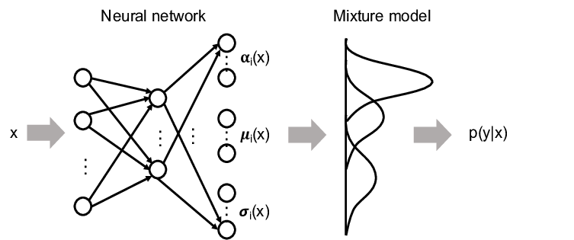
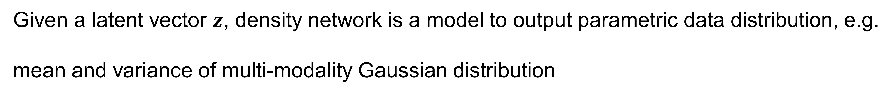
Early attempt: density network
Given a latent vector $z$, density network is a model to output parametric data distribution, e.g.
mean and variance of multi-modality Gaussian distribution
Allow effective sampling
Model is simple and easy to train
Limited representation power
10.1109/PMAPS.2018.8440559

Slide 9
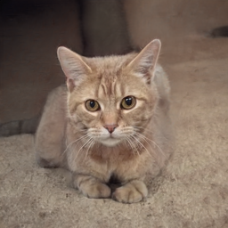
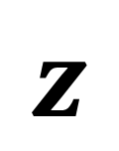
Modern generative model
Use deep neural network to learn data distribution
Directly generate sample, implicit modeling
Generator
$$z$$
e.g.
z=np.random.rand(N, D)
Picture is from Nvidia, style GAN
https://github.com/NVlabs/stylegan2

Slide 10
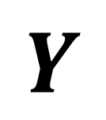
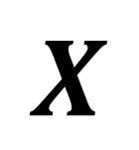
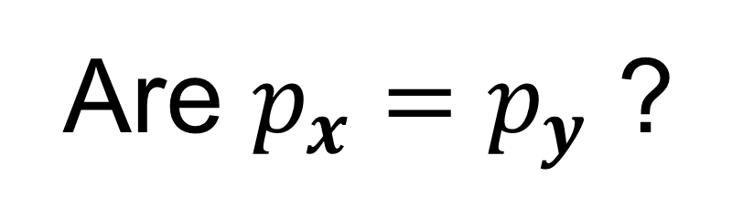
How to evaluate samples?
Two sample tests
Given two datasets $X$ and $Y$, assume the underlying data distribution is $p_{x}$ and $p_{y}$
$$X$$
$$Y$$
Are $p_{x}=p_{y}$ ?

Slide 11
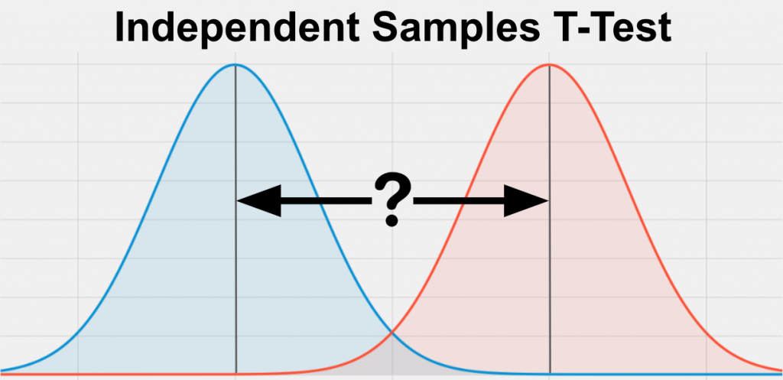
Two-sample tests
For low dimensional data, it is often performed by designing and comparing some statistics, e.g. t-test
Consider two sets of samples, are they from the same normal distribution?
Easy to perform
Very limited representation power
Difficult to design statistics for high dimensional data, e.g. images, musical waveforms …

Slide 12
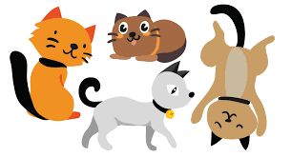
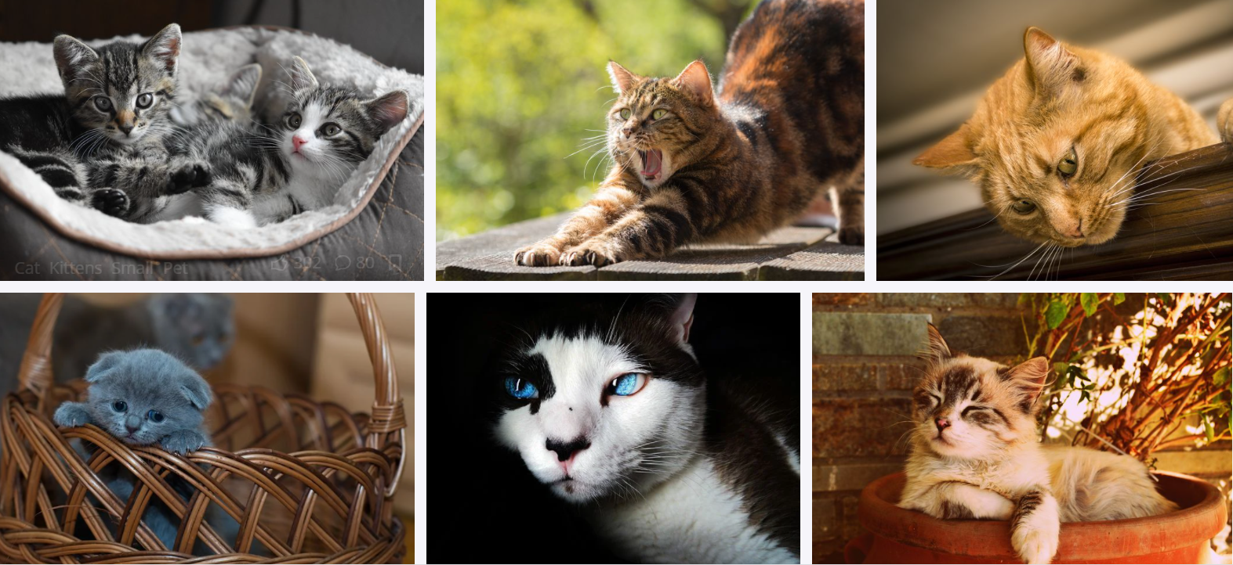
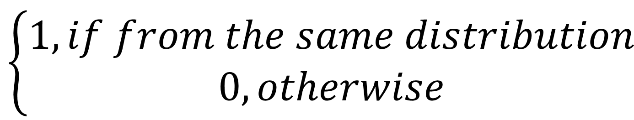
Use DNN for two-sample tests
Discriminator
$$\left\{\begin{aligned}1, if from the same distribution \\ 0, otherwise\end{aligned}\right.$$
Avoid the difficulty to design statistics
Use DNN representation power for this classification task
https://www.thehappycatsite.com/wp-content/uploads/2019/02/Cartoon-Cat-Names-long.jpg

Slide 13
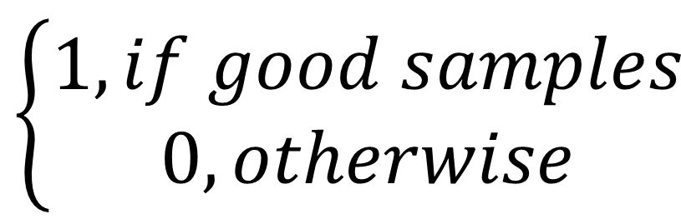
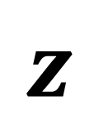
A linear design
A linear design
Generator
Discriminator
$$z$$
$$\left\{\begin{aligned}1, if good samples \\ 0, otherwise\end{aligned}\right.$$
e.g.
z=np.random.rand(N, D)
Two key ideas
Use DNN for generator and discriminator
Directly generate samples
Still hard to evaluate sample quality

Slide 14
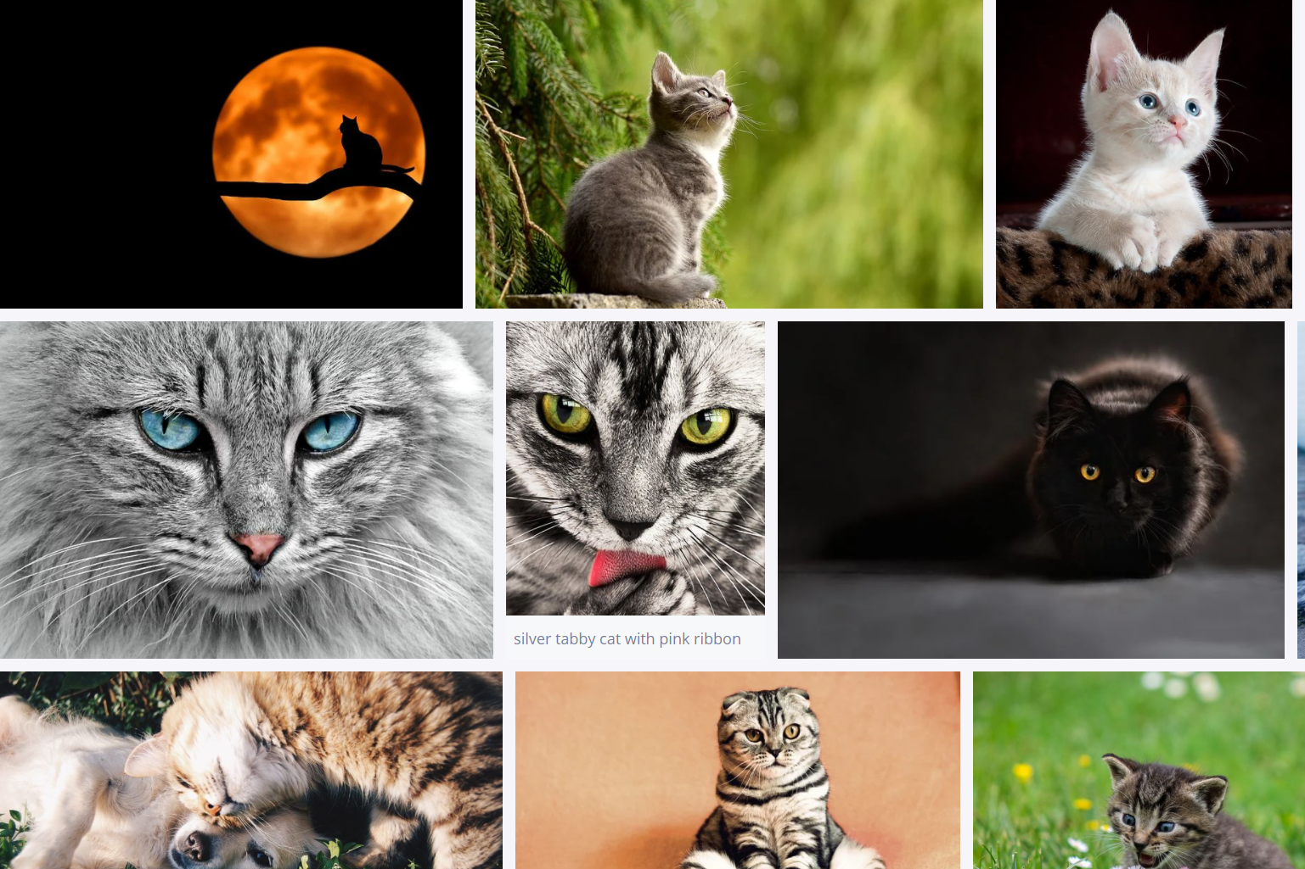
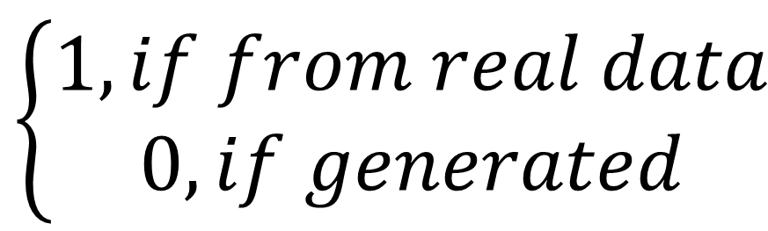
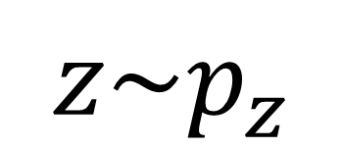
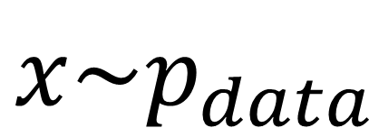
G/D gaming design
Generator
Discriminator
$$z\sim p_{z}$$
$$\left\{\begin{aligned}1, if from real data \\ 0, if generated\end{aligned}\right.$$
G(z)
$$x\sim p_{data}$$
Generative adversarial network
Three key ideas
Use DNN for generator and discriminator
Directly generate samples
G/D gaming design, give discriminator real samples to train
Ian J. Goodfellow et al. Generative Adversarial Nets. NIPS 2014.

Slide 15
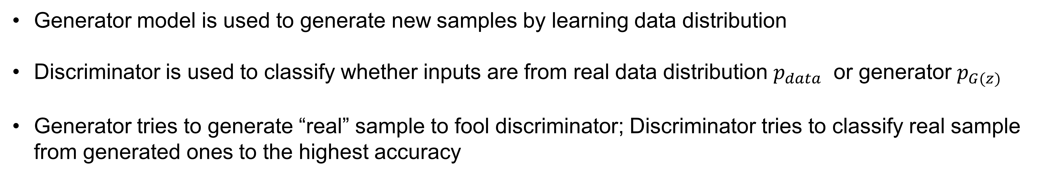
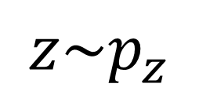
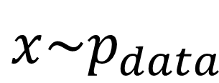
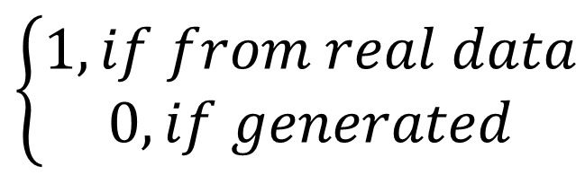
G/D gaming design
Generator
Discriminator
$$z\sim p_{z}$$
$$\left\{\begin{aligned}1, if from real data \\ 0, if generated\end{aligned}\right.$$
G(z)
$$x\sim p_{data}$$
Generative adversarial network
Generator model is used to generate new samples by learning data distribution
Discriminator is used to classify whether inputs are from real data distribution $p_{data}$ or generator $p_{G(z)}$
Generator tries to generate “real” sample to fool discriminator; Discriminator tries to classify real sample from generated ones to the highest accuracy
Ian J. Goodfellow et al. Generative Adversarial Nets. NIPS 2014.

Slide 16
GAN loss: Discriminator
When training D, G is fixed
$$\max_{D}{V\left(G,D\right)=E_{x\sim p_{data}}[logD(x)]+E_{x\sim p_{G}}[log⁡(1−D(x)]}$$
Recall the binary cross-entropy loss : $\log\left(y\right)+log⁡(1−y)$, y is the model probability
For a batch of samples from Real data distribution: $X\sim p_{data}$
Since $D\left(x\right)∈[0.0, 1.0]$, this term will be maximized when D(x)=1.0
For real samples from data distribution, discriminator assigns probability 1.0
For a batch of samples generated from generator: $X\sim p_{G}$ and $x=G\left(z\right)$
For fake samples generated by G, discriminator assigns probability 0.0

Slide 17
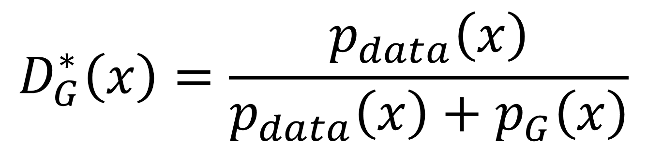
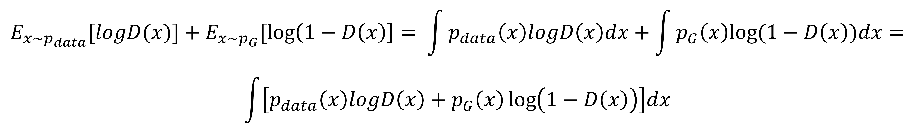
GAN loss: Discriminator
When training D, G is fixed
$$\max_{D}{V\left(G,D\right)=E_{x\sim p_{data}}[logD(x)]+E_{x\sim p_{G}}[log⁡(1−D(x)]}$$
$$E_{x\sim p_{data}}[logD(x)]+E_{x\sim p_{G}}[\log\left(1−D\left(x\right)\right]= \int{p_{data}\left(x\right)logD\left(x\right)dx+\int{p_{G}\left(x\right)log⁡(1−D\left(x\right))dx}}=$$
$$\int{\left[p_{data}\left(x\right)logD\left(x\right)+p_{G}\left(x\right)\log\left(1−D\left(x\right)\right)\right]dx}$$
What is the discriminator to maximize cost?
Give a specific x, take the derivative to D:
$$\frac{d\{p_{data}\left(x\right)logD\left(x\right)+p_{G}\left(x\right)\log\left(1−D\left(x\right)\right)\}}{dD}=\frac{p_{data}\left(x\right)}{D(x)}−\frac{p_{G}\left(x\right)}{1−D\left(x\right)}=0$$
Let the derivative be 0, we get the optimal discriminator:
$$D_{G}^{∗}\left(x\right)=\frac{p_{data}\left(x\right)}{p_{data}\left(x\right)+p_{G}\left(x\right)}$$

Slide 18
GAN loss: Generator
When training G, D is fixed
$\min_{G}{V\left(G,D\right)=E_{x\sim p_{data}}[logD(x)]+E_{x\sim p_{G}}[\log\left(1−D\left(x\right)\right]=}$
$$E_{x\sim p_{data}}[logD(x)]+E_{z\sim p_{z}}[\log\left(1−D\left(G(z)\right)\right]$$
Only the 2nd term has G
If the generator is so good that D is 100% fooled, with D(G(z))=1.0, loss is minimized ($−∞)$
$\min_{G}\max_{D}{V\left(G,D\right)=E_{x\sim p_{data}}[logD(x)]+E_{x\sim p_{G}}[\log\left(1−D\left(x\right)\right]=}$
$$E_{x\sim p_{data}}[logD(x)]+E_{z\sim p_{z}}[\log\left(1−D\left(G(z)\right)\right]$$
GAN loss is often written as this min-max problem: the goal is to jointly train two networks (D and G), maximize loss to train D and minimize loss to train G

Slide 19
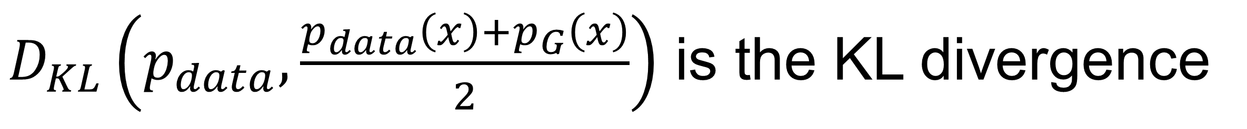
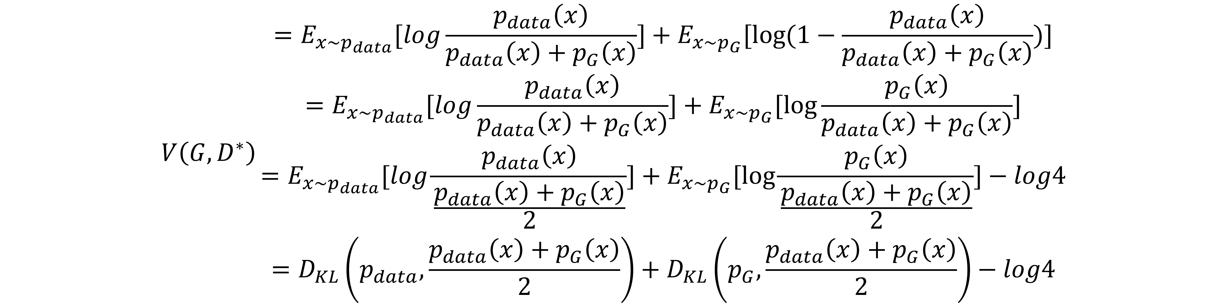
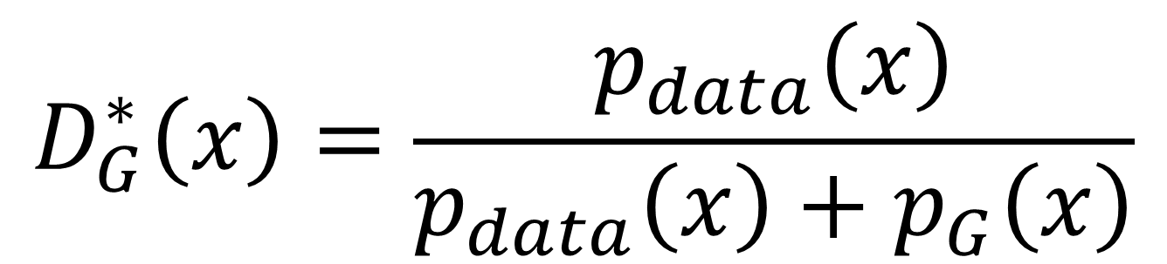
GAN loss: at the optimal point
$$V\left(G,D\right){=E_{x\sim p_{data}}[logD(x)]+E_{x\sim p_{G}}[log⁡(1−D(x)]}$$
$$D_{G}^{∗}\left(x\right)=\frac{p_{data}\left(x\right)}{p_{data}\left(x\right)+p_{G}\left(x\right)}$$
$$V\left(G,D^{∗}\right){\begin{aligned}=E_{x\sim p_{data}}[log\frac{p_{data}\left(x\right)}{p_{data}\left(x\right)+p_{G}\left(x\right)}]+E_{x\sim p_{G}}[\log{(1−\frac{p_{data}\left(x\right)}{p_{data}\left(x\right)+p_{G}\left(x\right)})]} \\ =E_{x\sim p_{data}}[log\frac{p_{data}\left(x\right)}{p_{data}\left(x\right)+p_{G}\left(x\right)}]+E_{x\sim p_{G}}[\log{\frac{p_{G}\left(x\right)}{p_{data}\left(x\right)+p_{G}\left(x\right)}]} \\ =E_{x\sim p_{data}}[log\frac{p_{data}\left(x\right)}{\frac{p_{data}\left(x\right)+p_{G}\left(x\right)}{2}}]+E_{x\sim p_{G}}[\log{\frac{p_{G}\left(x\right)}{\frac{p_{data}\left(x\right)+p_{G}\left(x\right)}{2}}]}−log4 \\ =D_{KL}\left(p_{data},\frac{p_{data}\left(x\right)+p_{G}\left(x\right)}{2}\right)+D_{KL}\left(p_{G},\frac{p_{data}\left(x\right)+p_{G}\left(x\right)}{2}\right)−log4\end{aligned}}$$
$D_{KL}\left(p_{data},\frac{p_{data}\left(x\right)+p_{G}\left(x\right)}{2}\right)$ is the KL divergence

Slide 20
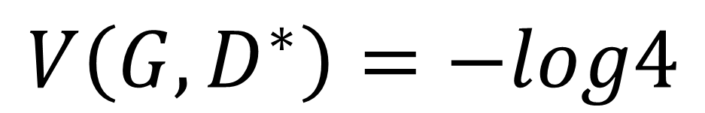
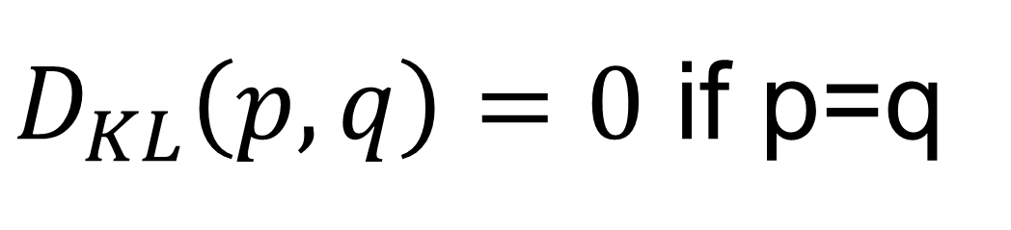
GAN loss: at the optimal point
$$V\left(G,D^{∗}\right){=D_{KL}\left(p_{data},\frac{p_{data}\left(x\right)+p_{G}\left(x\right)}{2}\right)+D_{KL}\left(p_{G},\frac{p_{data}\left(x\right)+p_{G}\left(x\right)}{2}\right)−log4}$$
$D_{KL}\left(p_{data},\frac{p_{data}\left(x\right)+p_{G}\left(x\right)}{2}\right)$ and $D_{KL}\left(p_{G},\frac{p_{data}\left(x\right)+p_{G}\left(x\right)}{2}\right)$ is the KL divergence
$D_{KL}\left(p,q\right)=0$ if p=q
Therefore, when we achieve the best discriminator, the best generate which minimizes the loss is
$$p_{G}=p_{data}$$
$$V\left(G,D^{∗}\right)=−log4$$
Theorem: If the generator can be updated in the functional space and discriminator is optimized in each step, this optimal loss can be achieved.
Ian J. Goodfellow et al. Generative Adversarial Nets. NIPS 2014.

Slide 21
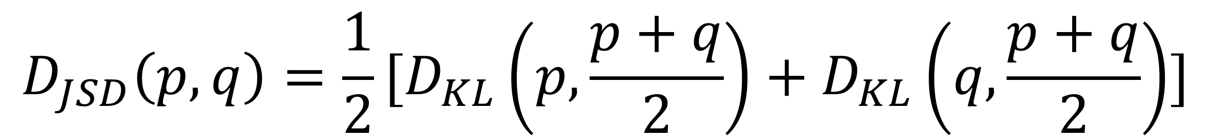
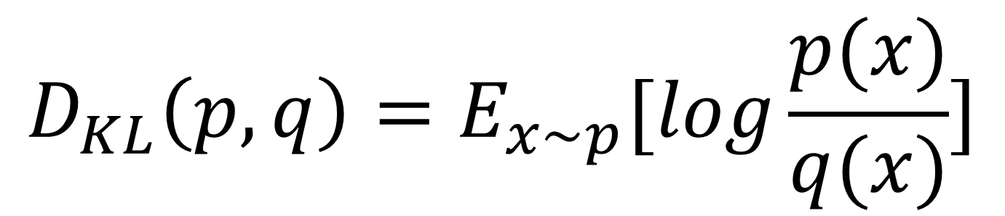
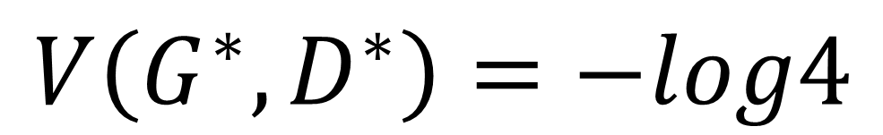
GAN loss: Jenson-Shannon Divergence
$$V\left(G,D^{∗}\right){=D_{KL}\left(p_{data},\frac{p_{data}\left(x\right)+p_{G}\left(x\right)}{2}\right)+D_{KL}\left(p_{G},\frac{p_{data}\left(x\right)+p_{G}\left(x\right)}{2}\right)−log4}$$
$$D_{KL}\left(p,q\right)=E_{x\sim p}[log\frac{p(x)}{q(x)}]$$
$D_{KL}\left(p,q\right)≥0$, $D_{KL}\left(p,q\right)==0 if p=q$, $D_{KL}\left(p,q\right)≠D_{KL}\left(q,p\right)$
KL Divergence
$$D_{JSD}\left(p,q\right)={\frac{1}{2}[D}_{KL}\left(p,\frac{p+q}{2}\right)+D_{KL}\left(q,\frac{p+q}{2}\right)]$$
Jenson-Shannon Divergence
$D_{JSD}\left(p,q\right)≥0$, $D_{JSD}\left(p,q\right)==0 if p=q$, $D_{JSD}\left(p,q\right)==D_{JSD}\left(q,p\right)$
$$V\left(G,D^{∗}\right)=2D_{JSD}\left(p_{data},p_{G}\right)−log4$$
When the generator is optimized,
$$V\left(G^{∗},D^{∗}\right)=−log4$$

Slide 22
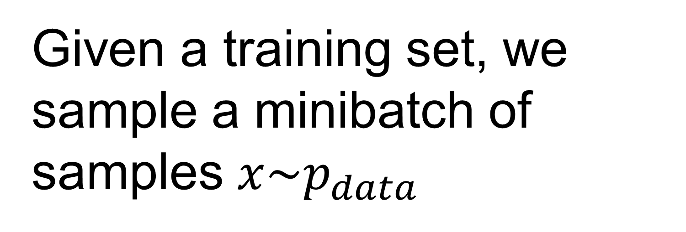




GAN : Training
For a batch of samples from Real data distribution: $X\sim p_{data}$
$$E_{x\sim p_{data}}\left[logD\left(x\right)\right]≈\frac{1}{B}\sum_{i=0}^{B−1}{logD(x^{(i)})}$$
For a batch of samples generated from generator: $Z\sim p_{z}$ and $G\left(z\right)$
$$E_{z\sim p_{z}}[log⁡(1−D(G\left(z\right))]≈\frac{1}{B}\sum_{i=0}^{B−1}{logD({G(z}^{\left(i\right)}))}$$
$$D$$
Z = np.random.rand(B, 256)
Given a training set, we sample a minibatch of samples $x\sim p_{data}$
Given a prior distribution, we sample latent vectors Z
$$p_{z}$$

Slide 23

GAN : Training
For every epoch
for k=0:K-1
Sample z
Sample x
Train D
Sample z
Train G
Ian J. Goodfellow et al. Generative Adversarial Nets. NIPS 2014.

Slide 24


GAN : Training
In every iteration, G learns the data distribution to challenge D
D
G
$$p_{data}$$
1
0.5
0
Ian J. Goodfellow et al. Generative Adversarial Nets. NIPS 2014.

Slide 25

GAN : Example architectures
Input vector reshape
Stride convolution to increase spatial resolution
Gradually reduce CONV channels with higher spatial resolution
BatchNorm, ReLU or LeakyReLU
Unsupervised Representation Learning with Deep Convolutional Generative Adversarial Networks. 2016. https://arxiv.org/pdf/1511.06434.pdf

Slide 26

GAN : Example architectures
Skip connections
Residual blocks
3x3 conv kernel
VGG type architecture for discriminator
Photo-Realistic Single Image Super-Resolution Using a Generative Adversarial Network. 2017. https://arxiv.org/pdf/1609.04802.pdf

Slide 27
GAN : Training
Generator
random vector z
At the beginning, generator was not trained and was randomly initialized
Most likely, the images generated will not be realistic

Slide 28

GAN : Training
$$E_{z\sim p_{z}}[\log\left(1−D\left(G(z)\right)\right]$$
D will have easy time to differentiate G(z) is faked (D(G(z))=0) at the beginning
$E_{z\sim p_{z}}[\log\left(1−D\left(G(z)\right)\right]$ reaches minima when D=1
$E_{z\sim p_{z}}[\log\left(D\left(G(z)\right)\right]$ reaches maxima when D=1
$$\max_{G}{V\left(G,D\right)=E_{x\sim p_{G}}[\log\left(D\left(x\right)\right]}$$
Non-saturated Generator loss

Slide 29

GAN : Training
If D gets trained faster that the generator, gradient from D to G will vanish
Vanishing gradient for generator
Model collapse
Unstable training
Sensitive to hyper parameters …
Often requires to check generated samples to evaluate the training process
D and G needs synchronized updates
https://jonathan-hui.medium.com/gan-why-it-is-so-hard-to-train-generative-advisory-networks-819a86b3750b

Slide 30

GAN : Training
Model collapse
G collapses to generate limited sample variety; these samples often are good, so D may be fooled
Some tricks can be found at
https://github.com/soumith/ganhacks
Example of model partially collapse to produce same sample
Figure 4. Wasserstein GAN. https://arxiv.org/abs/1701.07875

Slide 31


GAN : Progress is significant
2014
Ian J. Goodfellow et al. Generative Adversarial Nets. NIPS 2014.
Analyzing and Improving the Image Quality of StyleGAN. 2020
https://thispersondoesnotexist.com/
Try this website

Slide 32

GAN : Other objects
Trained with ImageNet images
Large Scale GAN Training for High Fidelity Natural Image Synthesis. arxiv:1809.11096, 2018.

Slide 33




GAN : Art generation
StyleGAN2. 2020

Slide 34

GAN : Video creation
DVD-GAN
DeepMind : Impressive Step Toward Realistic Video Synthesis, 2019

Slide 35



Conditional GAN
Generator
Discriminator
$$z\sim p_{z}$$
G(z)
$$\left\{\begin{aligned}1, if from real data given label y \\ 0, if generated\end{aligned}\right.$$
label y
$$(x,y)\sim p_{data}$$
Conditional GAN
Conditional Generative Adversarial Nets. https://arxiv.org/abs/1411.1784. 2014

Slide 36

Conditional GAN
Label 0 - 9
Conditional Generative Adversarial Nets. https://arxiv.org/abs/1411.1784. 2014

Slide 37
Conditional GAN
Label 0 - 9
Conditional Generative Adversarial Nets. https://arxiv.org/abs/1411.1784. 2014

Slide 38

Image to image translation: Conditional GAN with complicated label
Image-to-Image Translation with Conditional Adversarial Nets. https://arxiv.org/abs/1611.07004. 2018

Slide 39

Image to image translation: Conditional GAN with complicated label
mage-to-Image Translation with Conditional Adversarial Nets. https://arxiv.org/abs/1611.07004. 2018

Slide 40





CycleGAN : avoid 1-to-1 mapping between label and sample
$$G_{X→Y}$$
$$X$$
$$Y$$
$$G_{Y→Z}$$
Domain transformation with strong consistency

Slide 41

CycleGAN : avoid 1-to-1 mapping between label and sample
https://github.com/junyanz/CycleGAN/

Slide 42

CycleGAN : avoid 1-to-1 mapping between label and sample
Apply to every frame separately
https://github.com/junyanz/CycleGAN/

Slide 43







CycleGAN : avoid 1-to-1 mapping between label and sample
$$G_{X→Y}$$
Give two domains X and Y and corresponding samples
Two generators $G_{X→Y}$ and $G_{Y→X}$
Two discriminators $D_{X}$ and $D_{Y}$
Two GANs jointly optimized:
$$D_{X}$$
$$D_{Y}$$
$$X$$
$$Y$$
$$G_{Y→X}$$
$$\min_{G_{X→Y},G_{Y→X},D_{X},D_{Y}}{ℓ_{GAN}\left(X, Y,G_{X→Y},D_{Y}\right)+ℓ_{GAN}\left(X, Y,G_{Y→X},D_{X}\right)}$$

Slide 44







CycleGAN : avoid 1-to-1 mapping between label and sample
Cycle consistency needed
$$x$$
$$y$$
$$G_{Y→X}\left(G_{X→Y}\left(x\right)\right)$$
$$G_{X→Y}\left(x\right)$$
$$G_{Y→x}\left(y\right)$$
$$G_{X→Y}\left(G_{Y→x}\left(y\right)\right)$$
$$\min_{G_{X→Y},G_{Y→X},D_{X},D_{Y}}\left\{\begin{aligned}ℓ_{GAN}\left(X, Y,G_{X→Y},D_{Y}\right)+ℓ_{GAN}\left(X, Y,G_{Y→X},D_{X}\right) \\ +λ(E_{x\sim X}\left[{\left|G_{Y→X}\left(G_{X→Y}\left(x\right)\right)−x\right|}_{1}\right]+E_{y\sim Y}\left[{\left|G_{X→Y}\left(G_{Y→x}\left(y\right)\right)−y\right|}_{1}\right])\end{aligned}\right\}$$
https://junyanz.github.io/CycleGAN/
for great examples

Slide 45
CycleGAN : avoid 1-to-1 mapping between label and sample
Cycle consistency needed
$$x$$
$$y$$
$$G_{Y→X}\left(G_{X→Y}\left(x\right)\right)$$
$$G_{X→Y}\left(x\right)$$
$$G_{Y→x}\left(y\right)$$
$$G_{X→Y}\left(G_{Y→x}\left(y\right)\right)$$
$$\min_{G_{X→Y},G_{Y→X},D_{X},D_{Y}}\left\{\begin{aligned}ℓ_{GAN}\left(X, Y,G_{X→Y},D_{Y}\right)+ℓ_{GAN}\left(X, Y,G_{Y→X},D_{X}\right) \\ +λ(E_{x\sim X}\left[{\left|G_{Y→X}\left(G_{X→Y}\left(x\right)\right)−x\right|}_{1}\right]+E_{y\sim Y}\left[{\left|G_{X→Y}\left(G_{Y→x}\left(y\right)\right)−y\right|}_{1}\right])\end{aligned}\right\}$$
https://junyanz.github.io/CycleGAN/
for great examples

Slide 46

GAN framework is flexible
GAN is a flexible framework
Unique power is from the G/D gaming
Ability to sample with high resolution and details
The CycleGAN idea can be further extended to conditioned on labels too
Train GAN to transfer CT to MRI and MRI to CT
For medical imaging, the key anatomical structures should be kept consistent in generated images
Combine GAN loss, cycle loss and segmentation loss to achieve this
Translating and Segmenting Multimodal Medical Volumes with Cycle- and Shape-Consistency Generative Adversarial Network. https://arxiv.org/abs/1802.09655

Slide 47

























CycleGAN with segmentation consistency
Every sample comes with its segmentation label $(x,s_{x})$, $(y,s_{y})$
Train two more segmentation networks (e.g. use U-Net) : $S_{X}$ , $S_{y}$, receiving the images and generate segmentation results
$$S_{CT}$$
segmentation
$$ℓ_{seg}$$
$$D_{CT}$$
$$fake CT$$
$$s_{x}$$
$$G_{MR→CT}$$
$$ℓ_{GAN}$$
$$ℓ_{cycke}$$
$$x$$
$$G_{CT→MR}$$
$$\min_{\begin{aligned}\begin{aligned}\begin{aligned}G_{CT→MR}, \\ G_{MR→CT},\end{aligned} \\ D_{MR},D_{CT},\end{aligned} \\ S_{MR},S_{CT}\end{aligned}}\left\{\begin{aligned}ℓ_{GAN}\left(CT, MR,G_{CT→MR},D_{MR}\right) \\ +ℓ_{GAN}\left(CT, MR,G_{MR→CT},D_{CT}\right) \\ +λℓ_{cycle}\left(CT, MR,G_{CT→MR},G_{MR→CT}\right)) \\ +βℓ_{seg}\left(CT, MR,S_{MR},S_{CT},G_{CT→MR},G_{MR→CT}\right)\end{aligned}\right\}$$
$$ℓ_{cycke}$$
$$y$$
$$fake MR$$
$$D_{MR}$$
$$ℓ_{seg}$$
$$ℓ_{GAN}$$
$$S_{MR}$$
$$s_{y}$$
$ℓ_{seg}$ can be pixel-wise cross-entropy loss or soft Dice loss or combined
Translating and Segmenting Multimodal Medical Volumes with Cycle- and Shape-Consistency Generative Adversarial Network. https://arxiv.org/abs/1802.09655

Slide 48

CycleGAN with segmentation consistency
Translating and Segmenting Multimodal Medical Volumes with Cycle- and Shape-Consistency Generative Adversarial Network. https://arxiv.org/abs/1802.09655

Slide 49


More resources
https://github.com/hindupuravinash/the-gan-zoo

